Slide 1
Functions & Data
A Lecture for the c++ Course
Each slide has its own narration in an audio file. For the explanation of any slide, click on the audio icon to start the narration.
The Professor‘s C++Course by Linda W. Friedman is licensed under a Creative Commons Attribution-NonCommercial-ShareAlike 3.0 Unported License.

Slide 2
Functions and Data
When writing a program in modules – functions – there are several ways in which we deal with data, depending on our needs. Some issues:
Data may be required by the function, an input value much like f(x) in math.
The function may compute a value that must be returned back to the point of call, again, much like a mathematical function, y=f(x).
The function may have more than one data value to return to the point of call – or none at all.
The function may only use certain data items locally.
The function may be required to change the values of data used elsewhere in the program.

Slide 3
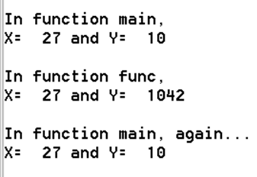
Global and local variables
Global variables – a.k.a. external variables – are accessible throughout all the functions in the program.
Local variables – a.k.a. automatic variables – are accessible only within the function (or other program module) in which they are declared.
#include <iostream>
using namespace std;
void func(); //function prototype
int x=27, y=10; //global variables
int main(){
cout << "\nIn function main, " << endl;
cout << "X= " << x << " and Y= " << y << endl;
func();
cout << "\nIn function main, again..." << endl;
cout << "X= " << x << " and Y= " << y << endl;
return 0;
}
void func(){ //function implementation
int y = 1042; //local variable
cout << "\nIn function func, " << endl;
cout << "X= " << x << " and Y= " << y << endl;
}

Slide 4
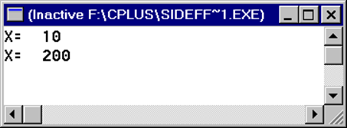
Side effects
A side effect is an unintended change to a global variable from within a function.
#include <iostream>
using namespace std;
void SideEffects();
int x;
int main(){
x=10;
cout << "X= " << x << endl;
SideEffects(); // not clear here why the function call might
//change the value of x
cout << "X= " << x << endl;
return 0;
}
void SideEffects(){
x = 200;
}

Slide 5
scope
Every name (identifier) in a C++ program must refer to a unique entity. This does not mean that a name can be used only once. Sometimes, context is important.
Scope refers to the area of the program code where a declared variable (or object or function or …) is accessible, i.e., where it can be referenced. Depending on its scope, a variable may exist (lifetime) but still not be visible.
Local scope – local to function, block of code (compound statement)
Namespace scope; class scope [Later]
The lifetime of a variable is the duration of time during which it takes up space in memory, i.e., it exists.

Slide 6
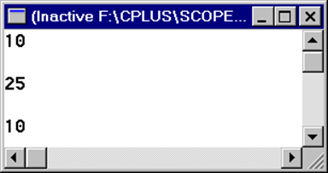
scope
Example:
#include <iostream>
using namespace std;
int main(){
int x=10;
cout << x << endl << endl;
{
int x=25;
cout << x << endl << endl;
}
cout << x << endl << endl;
return 0;
}

Slide 7
Static variables
A static variable looks like a local variable but it does not “die” when the function returns and retains its value for the next time the function is called. It is only accessible when the function is executing.
#include <iostream>
using namespace std;
//This program prints a ‘running’ average
double average (double x){
static double count = 0;
static double sum = 0;
count++;
sum += x;
return sum / count;
}
int main(){
cout << "average = " << average(1) << endl;
cout << "average = " << average(2) << endl;
cout << "average = " << average(6) << endl;
cout << "average = " << average(11) << endl;
cout << "average = " << average(5) << endl;
cout << endl << endl;
return 0;
}

Slide 8
Static variables and storage classes
Static is a storage class.
Other storage classes are
extern, for external – or global – variables
auto, for automatic – or local – variables

Slide 9
Parameter passing
We know that when we call a function, we can pass data to it in the parameter list.
An actual parameter, or argument, is the data item that is passed from the calling function to the called function.
A formal parameter, or parameter, is the variable in the parameter list in the function implementation.
So far, our examples have used the default parameter passing mechanism, pass by value. The value of the argument is copied into the corresponding parameter; it is similar to a local variable in the executing function.

Slide 10
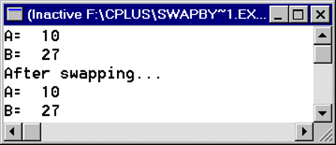
Parameter passing
Suppose we wish to write a function that will swap two numeric values. It might look something like this:
void swap (float x, float y){
float temp = x;
x = y;
y = temp;
}
How does this work? Let's see (it doesn't). Here's a program to test this swap function:
#include <iostream>
using namespace std;
void swap (float, float);
int main(){
float a = 10;
float b = 27;
cout << "A= " << a << endl
<<"B= " << b << endl;
swap(a,b);
cout << "After swapping..." << endl
<< "A= " << a << endl
<<"B= " << b << endl;
return 0;
}

Slide 11
Parameter passing
Why didn't the swap take place? After all, the function looks like it should work, but it doesn't work properly.
x and y, the formal parameters of swap are considered local to swap. Only the values of a and b (10 and 27) are passed to the swap function. Any changes that take place inside the function, stay there and do not get sent back to the actual parameters in the calling function. This is to protect our variables from unintentional modification. And is usually the best way to pass actual parameters (arguments) to formal parameters. Clearly, this doesn't work in all cases!
For the swap function to work as intended, we need to pass a reference to the location of the actual parameter so that it can be modified by the function. This is called passing by reference.

Slide 12
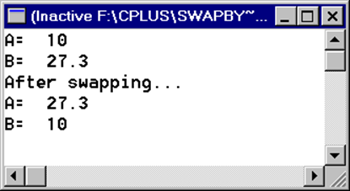
Parameter passing
Trying again with reference parameters:
#include <iostream>
using namespace std;
void swap (float&, float&);
int main(){
float a = 10;
float b = 27.3;
cout << "A= " << a << endl
<<"B= " << b << endl;
swap(a,b);
cout << "After swapping..." << endl
<< "A= " << a << endl
<<"B= " << b << endl;
return 0;
}
void swap (float &x, float &y){
float temp = x;
x = y;
y = temp;
}

Slide 13
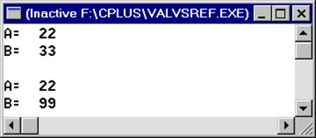
Parameter passing
Exercise – what will output?
//from Hubbard book
#include <iostream>
using namespace std;
void testing(int, int&);
int main(){
int a = 22, b = 33;
cout << "A= " << a << endl
<<"B= " << b << endl << endl;
testing(a,b);
cout << "A= " << a << endl
<<"B= " << b << endl;
return 0;
}
void testing (int x, int &y) {
x = 88; y = 99;
}

Slide 14
Parameter passing
Play computer – Exercise #1:
#include <iostream>
void fun (int&, int&, int&);
int main(){
int a, b, c;
…
a = 27; b = 10; c = 3;
fun (a, 9, b+c);
cout << a;
…
return 0;
}
fun (int &x, int &y, int &z){
x = x + y + z;
}

Slide 15
Parameter passing
Play computer – Exercise #1. Here we are passing by reference.

Slide 16
Parameter passing
Play computer – Exercise #2:
#include <iostream>
void fun (int, int, int);
int main(){
int a, b, c;
…
a = 27; b = 10; c = 3;
fun (a, 9, b+c);
cout << a;
…
return 0;
}
fun (int x, int y, int z){
x = x + y + z;
}

Slide 17
Parameter passing
Play computer – Exercise #2. Here we are passing by value.

Slide 18
Parameter passing
Overview
Passing by Value | Passing by Reference
int x; | int &x;
Formal parameter is a local variable | Formal parameter is a local reference
Formal parameter is a duplicate of the actual parameter | Formal parameter is a synonym for the actual parameter
Formal parameter cannot change the actual parameter | Formal parameter can change the actual parameter
Actual parameter may be constant, variable, or expression | Actual parameter must be a variable
Actual parameter is read-only | Actual parameter is read-write

